Slide 1

Data Science: Data Cleaning, EDA, and Visualization
Welcome to this exploration of data science, focusing on the critical steps of data cleaning, exploratory data analysis (EDA), and visualization. This presentation will provide insights into the process of preparing and understanding data, using powerful tools like Python and Tableau.
FA
by Faiza Ali

Slide 2
Introduction to Data Cleaning
What is Data Cleaning?
Why is it Important?
Data cleaning is the process of identifying and correcting errors, inconsistencies, and inaccuracies in data. It involves ensuring data quality and reliability for accurate analysis.
Clean data is essential for accurate insights and reliable decision-making. Unclean data can lead to skewed analysis, misleading conclusions, and flawed predictions.

Slide 3
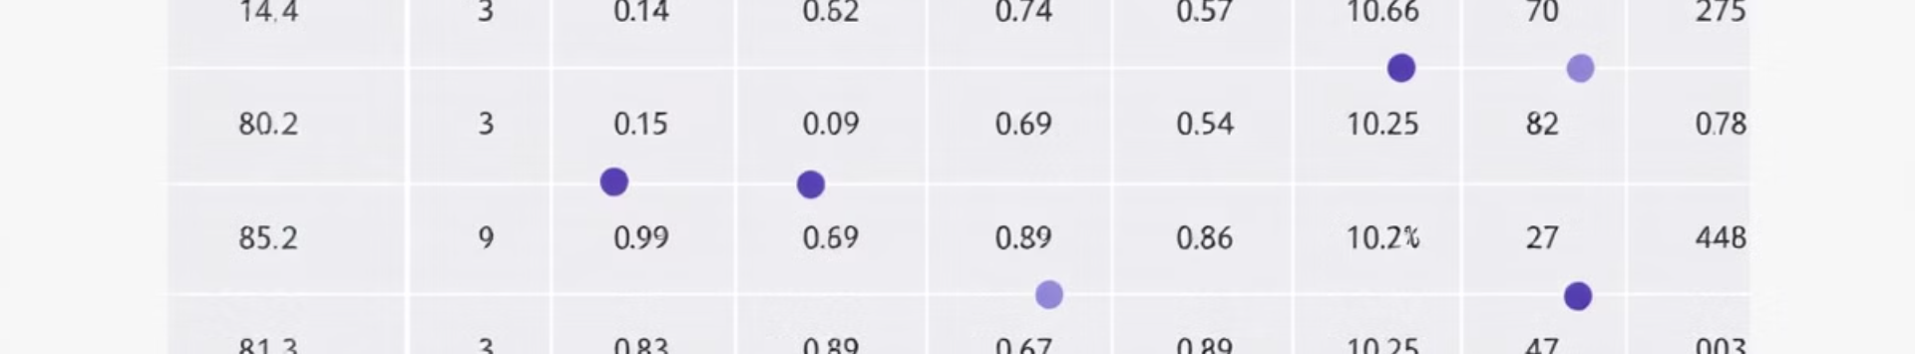
Handling Missing Data
Deletion
Imputation
Model-based Imputation
Removing rows or columns with missing values. Simple but potentially loses information.
Replacing missing values with estimated values. Can be done using mean, median, or other methods.
Utilizing machine learning models to predict missing values based on patterns in the data.

Slide 4


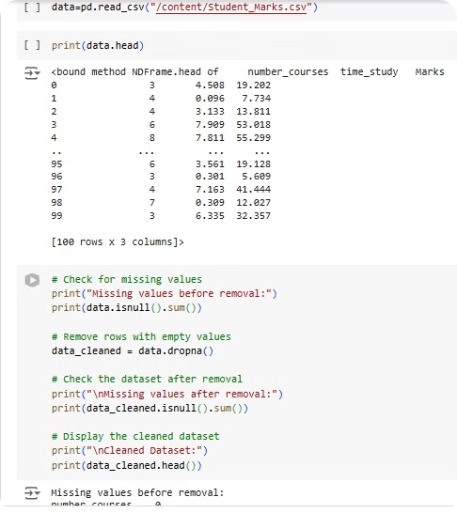


Handling Outliers
Removal
Outliers can be removed if they are clearly erroneous or if they significantly distort the analysis.
Transformation
Applying transformations like logarithmic or square root to reduce the impact of outliers.
Capping
Setting limits on data values, replacing extreme values with the maximum or minimum allowed value.

Slide 5

Exploratory Data Analysis (EDA)
1
1. Understand Data
2
2. Identify Patterns
Explore variables, data types, and relationships between variables.
Discover trends, correlations, and anomalies within the data.
3
3. Formulate Hypotheses
Generate insights that can lead to further investigation and analysis.

Slide 6

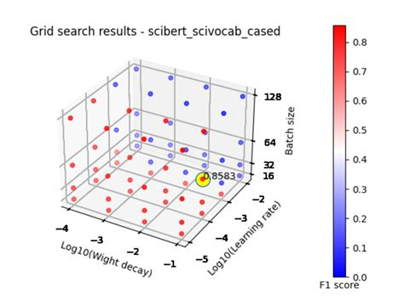
Plotting with Python
1
Matplotlib
A foundational library for creating static, interactive, and animated visualizations.
2
Seaborn
Built on top of Matplotlib, Seaborn provides a high-level interface for attractive statistical graphics.
3
Plotly
Offers interactive visualizations that can be embedded in web applications or dashboards.

Slide 7



Introduction to Tableau
Drag and Drop
1
Effortless visualization creation with intuitive drag-and-drop functionality.
Data Connectivity
2
Connects to various data sources, including spreadsheets, databases, and cloud platforms.
Interactive Dashboards
3
Build engaging dashboards that allow users to explore data and gain insights.

Slide 8
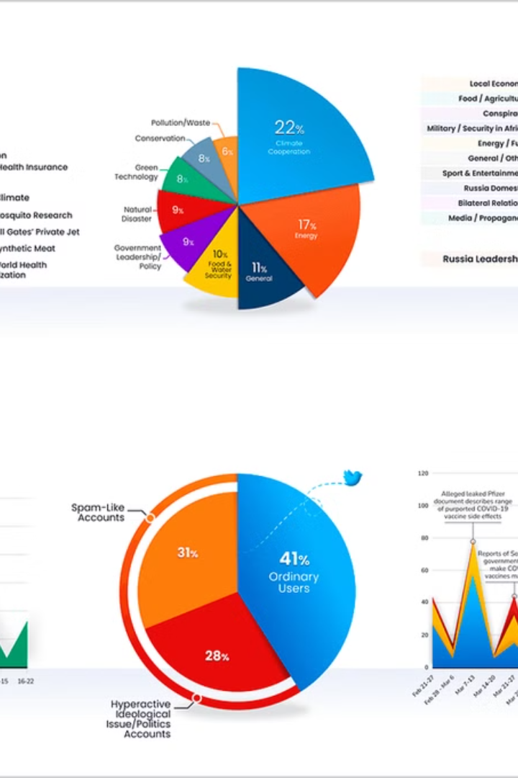
Tableau Dashboards and Visualizations
Bar Charts
1
Compare categories and illustrate differences.
Line Charts
2
Show trends over time.
Scatter Plots
3
Reveal relationships between variables.
Heat Maps
4
Visualize patterns and correlations.

